Slide 1
IT1311 Decision Analysis Data-driven Decision Making
Bayes’ Theorem

Slide 2
Decision Trees and Bayes’ Theorem
We agree that sampling and survey are possible ways to obtain information to better predict the probability estimates for the states of nature
Prior to obtaining this information, the probability estimates for the states of nature are called prior probabilities
With knowledge of conditional probabilities for the outcomes of the sampling or survey information, these prior probabilities can be revised by employing Bayes' Theorem
The outcomes of this analysis are called posterior probabilities or branch probabilities for decision trees

Slide 3
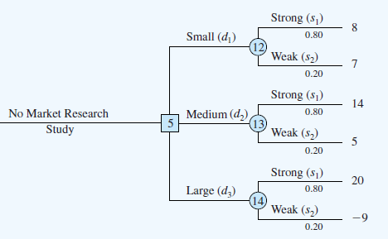
PDC Scenario Continued - No market research
If the market research study is not undertaken, no change to the earlier predicted probabilities:
P(Strong demand) = P(s₁) = 0.80
P(Weak demand) = P(s₂) = 0.20
No change (same as before)
No change (same as before)

Slide 4
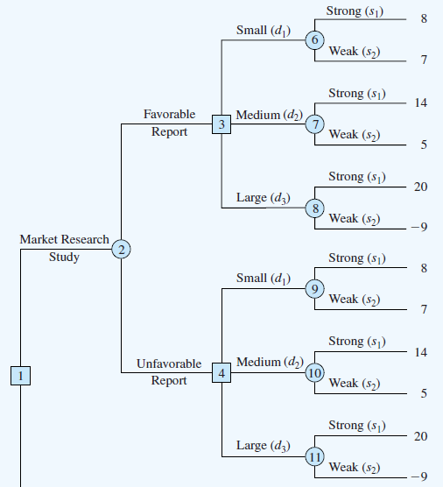
PDC Scenario Continued - Market research
If PDC can engage a marketing agent to conduct a market research before building the condominium, they can better predict the probabilities
The final decision tree taking the market research into account is shown here
(compared it to the one showed in slide 17)
The tree has to be built using conditional probabilities to examine all possible outcomes in each branch
Eg. P(A | B) means
probability of A given B

Slide 5
PDC Scenario Continued - Change in prob
Let’s look at how the market research changes the probabilities
Based on past experiences, the management has estimated (prior probabilities) :
P(Strong demand)=0.8
P(Weak demand)=0.2
After conducting a market survey, the management has revised their estimations (posterior probabilities)to:
P(Strong demand | favorable report) =0.94
P(Weak demand | favorable report) = 0.06
P(Strong demand | unfavorable report) =0.35
P(Weak demand | unfavorable report) = 0.65
How these revised
probabilities are computed?
Please remember : P(A | B) = P(A n B) / P(B)

Slide 6
P(B|A) vs P(A|B)
B
A
P(B|A)
P(A|B)
A
B

Slide 7
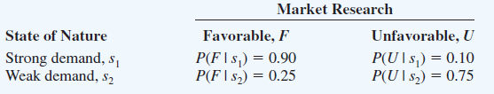
PDC Scenario Continued - Conditional Prob
P(F|S)
Favorable given Strong
P(F n S) = (0.8)(0.9)=0.72
0.9
Strong
demand
0.1
0.8
P(U|S)
P(U n S) = (0.8)(0.1)=0.08
Unfavorable given Strong
0.2
P(F|W)
Favorable given Weak
Weak
demand
P(F n W)= (0.2)(0.25) = 0.05
0.25
0.75
P(U|W)
P(U n W) = (0.2)(0.75) = 0.15
Unfavorable given Weak

Slide 8
P(F|S)
Favorable given Strong
P(F n S) = (0.8)(0.9)=0.72
0.9
Strong
demand
0.1
0.8
P(U|S)
P(U n S) = (0.8)(0.1)=0.08
Unfavorable given Strong
0.2
P(F|W)
Favorable given Weak
Weak
demand
P(F n W)= (0.2)(0.25) = 0.05
0.25
0.75
P(U|W)
P(U n W) = (0.2)(0.75) = 0.15
Unfavorable given Weak
P(Strong demand | favorable report)
= P(Strong demand AND Favourable report)/ P(Favourable report)
P(F) = 0.72+0.05 = 0.77
P(U) = 0.08 + 0.15 = 0.23

Slide 9
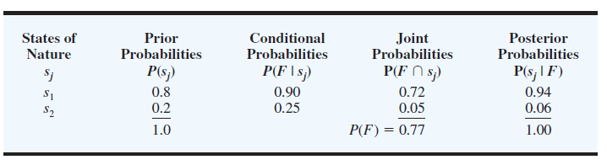
PDC Scenario Continued - calculating the branch probability
In the PDC problem, we need to know the conditional probability of a favourable market research report given that the state of nature is strong demand for the PDC project
So we assume that we are given the following conditional probabilities:

Slide 10
PDC Scenario Continued - steps in calculating the branch probability
Step 1. In column 1 enter the states of nature. In column 2 enter the prior probabilities for the states of nature. In column 3 enter the conditional probabilities of a favourable market research report (F) given each state of nature
Step 2. In column 4 compute the joint probabilities by multiplying the prior probability values in column 2 by the corresponding conditional probability values in column 3
Step 3. Sum the joint probabilities in column 4 to obtain the probability of a favourable market research report, P(F)
Step 4. Divide each joint probability in column 4 by P(F) 0.77 to obtain the revised or posterior probabilities, P(s1 | F) and P(s2 | F)

Slide 11
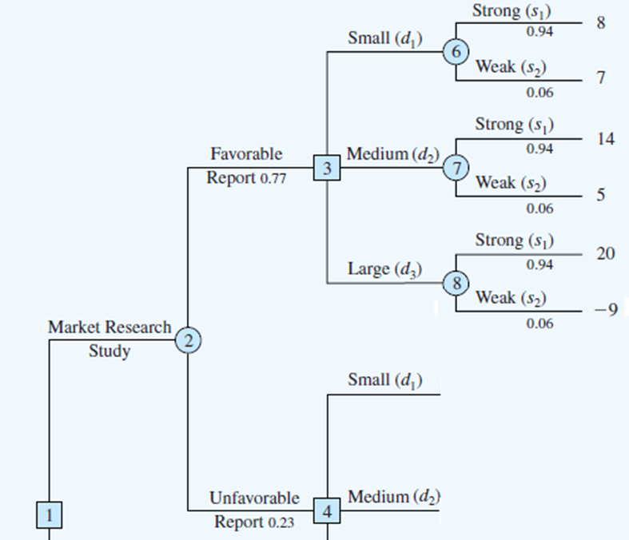
PDC Scenario Continued – Putting probabilities into the fav branch
If the market research study is undertaken:
P(Favorable report) = P(F) = 0.77
P(Unfavorable report) = P(U) = 0.23
If the market research report is favorable:
P(Strong demand | favorable report)
= P(s₁|F) = 0.94
P(Weak demand | favorable report)
= P(s₂|F) = 0.06
(revised from 0.8 to 0.94)
(revised from 0.2 to 0.06)

Slide 12
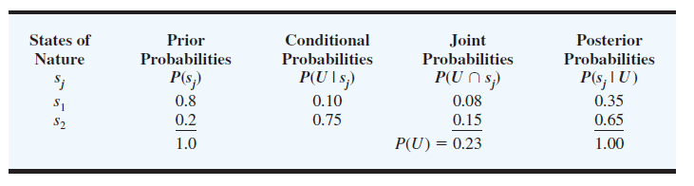
PDC Scenario Continued - calculating the branch probability
Similarly for the unfavourable market research report, we use the same steps to compute the Posterior probabilities

Slide 13
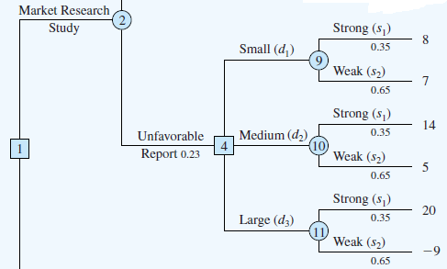
PDC Scenario Continued – Putting probabilities into the unfav branch
If the market research report is unfavorable:
P(Strong demand |unfavorable report) = P(s₁|U) = 0.35
P(Weak demand |unfavorable report) = P(s₂|U) = 0.65
(revised from 0.8 to 0.35)
(revised from 0.2 to 0.65)

Slide 14
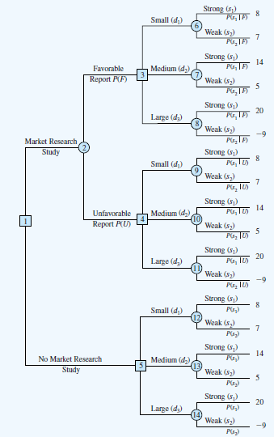
PDC Scenario Continued – Full Decision Tree
The decision tree on the right summarizes all the branch probabilities discussed so far
Our decision strategy now is to base on a backward pass using the steps below:
At chance nodes, compute the expected value which is
(payoff x branch probabilities)
At decision nodes, select the decision branch that leads to the best expected value

Slide 15
PDC Scenario Continued – Exp Value
d₁
6
EV = 0.94(8) + 0.06(7) = $7.94 mil
EV = $18.26 mil
d₂
F
(0.77)
3
7
EV = 0.94(14) + 0.06(5) = $13.46 mil
d₃
How to get this value?
EV (node 2) = $15.93 mil
8
EV = 0.94(20) + 0.06(-9) = $18.26 mil
2
d₁
9
EV = 0.35(8) + 0.65(7) = $7.35 mil
U
(0.23)
d₂
4
10
EV =0.35(14) + 0.65(5) = $8.15 mil
d₃
1
EV = $8.15 mil
11
EV = 0.35(20) + 0.65(-9) = $1.15 mil
EV =
$15.93 mil
d₁
12
EV = 0.8(8) + 0.2(7) = $7.80 mil
d₂
5
13
EV = 0.8(14) + 0.2(5) = $12.20 mil
d₃
EV = $14.20 mil
14
EV = 0.8(20) + 0.2(-9) = $14.20 mil

Slide 16
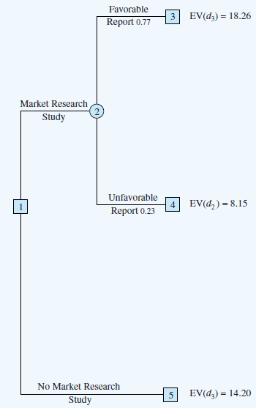
PDC Scenario Continued – Final Decision
d₃ is Large cond.
The optimal decision for PDC is to conduct the market research study and then carry out the following decision strategy:
If the market research is favourable, construct the large condominium complex.
If the market research is unfavourable, construct the medium condominium complex.
15.93
d₂ is Medium cond.

